Slide 1

Walmart Superstore Sales Analysis
Capstone 2
MBT 7
- Janardhan

Slide 2

Summary
This report analyzes Walmart's sales performance and revenue drivers. It covers 2011-2014 data, focusing on category performance and regional revenue. The objective is to identify trends and opportunities for revenue optimization and expansion.

Slide 3





Key Performance Indicators
Total Sales: $725K
New Customers: 686
Units Sold: 12k
Profit Margin: 14.9%

Slide 4
Product Category Performance
Technology Revenue
1
91% Growth
2
Office Supplies Revenue
87% Growth
Furniture Revenue
3
18% Growth
Technology is the fastest-growing category. Further investments can maximize potential.

Slide 5
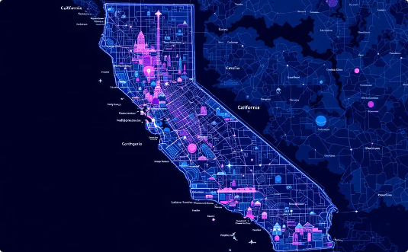


Regional Sales Performance
California
Washington
Untapped Potential
$534K, 33% of total sales
$172K, Significant revenue
Other states show market potential and opportunity for growth.
California and Washington are key revenue drivers.

Slide 6
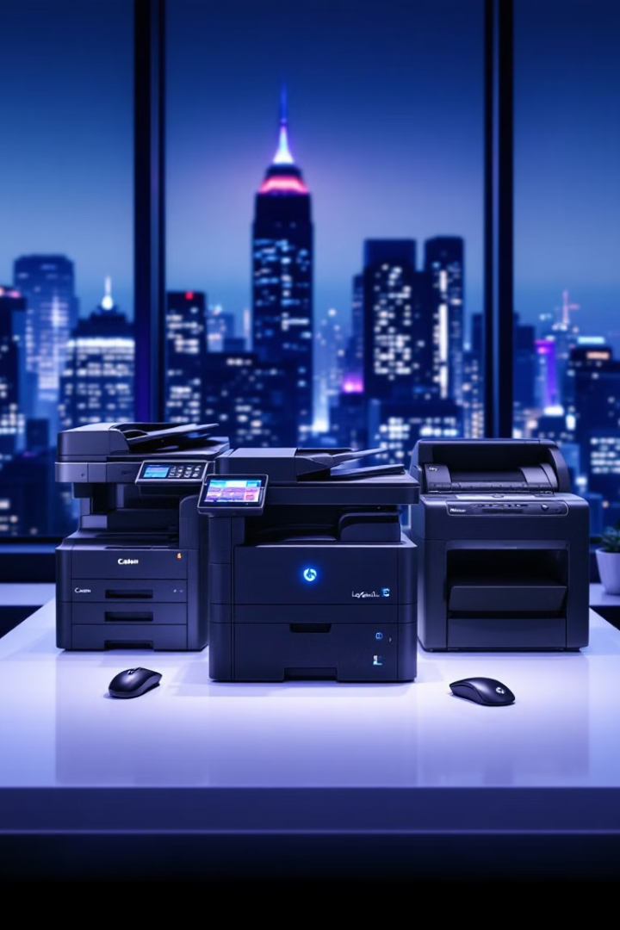
Top Revenue-Generating Products
1
Canon Copier
2
Logitech Mouse
Revenue: $20,720
Revenue: $13,620
3
Fellowes Machine
Revenue: $11,180
Expanding inventory for top products can maximize sales. Market trends can help identify new, high-demand products.

Slide 7




Shipping Mode Analysis
Standard
55% of revenue
Standard Class dominates shipping, balancing cost and efficiency.
Same-Day shipping contributes the least revenue, indicating limited consumer demand.
Encouraging First-Class shipping for premium customers for increased revenue.
Cost-reduction strategies for Same-Day shipping to improve its profitability.
Second Class
20% of revenue
First Class
18% of revenue
Same-Day
6% of revenue

Slide 8


Customer Segmentation: The 80/20 Rule
Top 20%
Remaining 80%
1
2
76% of revenue
24% of revenue
Top customers drive most revenue. Loyalty programs and personalized marketing are highly recommended.

Slide 9
Strategic Recommendations
Enhance Product Categories
Expand top sellers and improve Furniture.
Strengthen Engagement
Offer loyalty programs for high-value customers.
Optimize Profitability
Expand in low-revenue states.
Improve Shipping
Promote First-Class shipping for premium price.
Data-driven strategies in customer segmentation and regional expansion will enhance sales and profitability.

Slide 10





Key Takeaways & Next Steps
Optimize Supply Chain
Loyalty Programs
Pricing Strategy
Shipping Incentives
Address key factors to drive growth, improve efficiency, and enhance customer satisfaction.

Slide 11




Root Cause Analysis: Walmart Store Performance
High operational costs &
weak market presence
High prices, limited product range
Low profit margins, especially
Same-Day.
1
2
Reduce costs by negotiating contracts and offering tiered pricing.
Implement Loyalty Program
Underutilization of Same-Day Shipping
4
3
Introduce a points-based loyalty program with exclusive benefits.
Offer free shipping for high-value purchases & improve partnerships

Slide 12
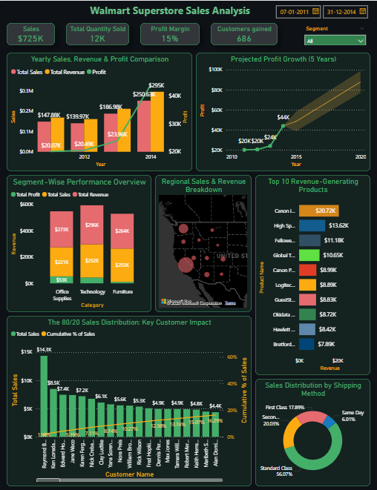

Dashboard

Slide 13
THANK YOU

